Slide 1


Data Analytics Using
Power BI
Adventure Dataset Analysis
Presented by:
The Dream Team

Slide 2

Power BI
Power BI is a business analytics tool by Microsoft that enables users to visualize data, share insights, and create interactive reports and dashboards. It connects to various data sources, transforming raw data into meaningful information, facilitating informed decision-making and enhancing business intelligence capabilities across organizations.
Power BI Components
Power BI Service
Power Query
Power Pivot
Power View

Slide 3
The First Step:
Data Cleaning
Importance of Data cleaning
Data cleaning in Power BI involves removing inaccuracies, handling missing data, and correcting inconsistencies to ensure accurate analysis. It's crucial because clean data leads to more reliable insights, better decision-making, and enhances overall data quality. Without proper cleaning, visualizations and reports may be misleading or incorrect.
Power Query
Power Query in Power BI is a tool for ETL (Extract, Transform, Load) processes. It allows users to extract data from various sources, transform it by cleaning and reshaping, and then load it into Power BI for analysis. It streamlines data preparation, making complex tasks simple and efficieint.

Slide 4
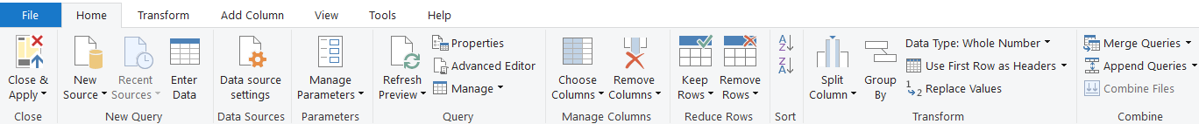
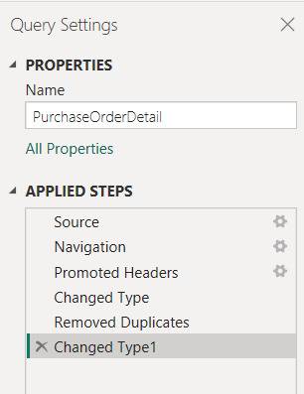
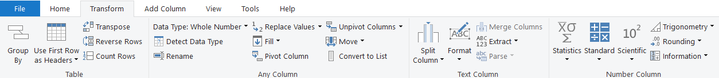
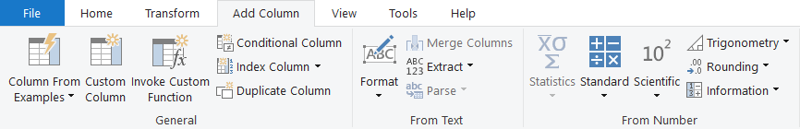
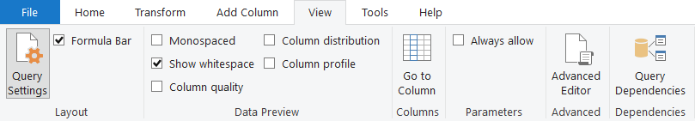
Features of Power Query

Slide 5
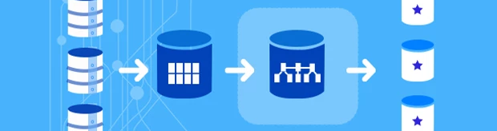
The Second Step:
Data Modelling
Data modeling in Power BI involves structuring data relationships and organizing tables to optimize analysis and reporting. It defines how data tables connect through relationships, enabling accurate insights.
STAR SCHEMA
SNOWFLAKE SCHEMA
A star schema is a database design where a central fact table links to multiple dimension tables, forming a star-like structure. It's efficient for simplifying queries and improving performance.
A snowflake schema is a normalized data model where dimension tables are split into related sub-tables, reducing redundancy. It optimizes storage but makes queries more complex than a star schema.

Slide 6
Dataset Transformation
#1
Vendor ID in the Purchase Order Header was changed to Business Entity ID. This was done because both had the same number formats and were relevant to each other. Vendor ID had duplicates, and we wanted to establish a many-to-one (*:1) relationship. By doing this, the original data and the drawn insights were not affected.
HOME TAB
Close and Apply
Data Source Settings: Path
Refresh Preview
Remove Columns
Replace Values
Remove Duplicates
TRANSFORM TAB
Change Data Type
#2
The 'Purchase Order Detail ID' was added to create a common key between the Purchase Order Header and Details tables. Unique values were filled repetitively, nulls replaced with zero, maintaining data integrity and justifying many-to-one relationship.
VIEW TAB
Column Quality
Colum Profile
Column Distribution

Slide 7
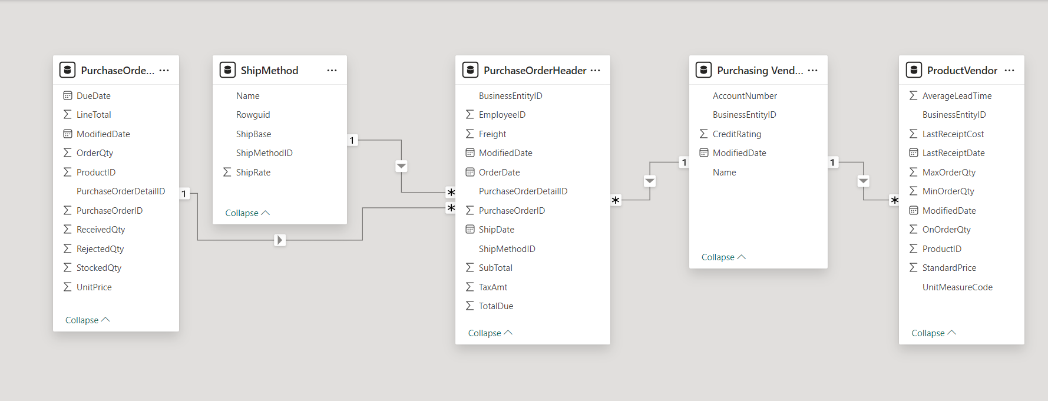
Snowflake Schema

Slide 8
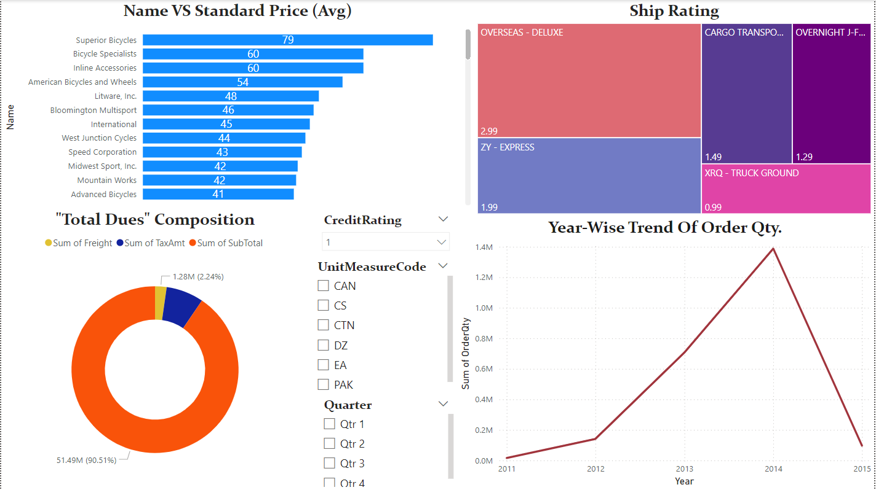
Report View

Slide 9
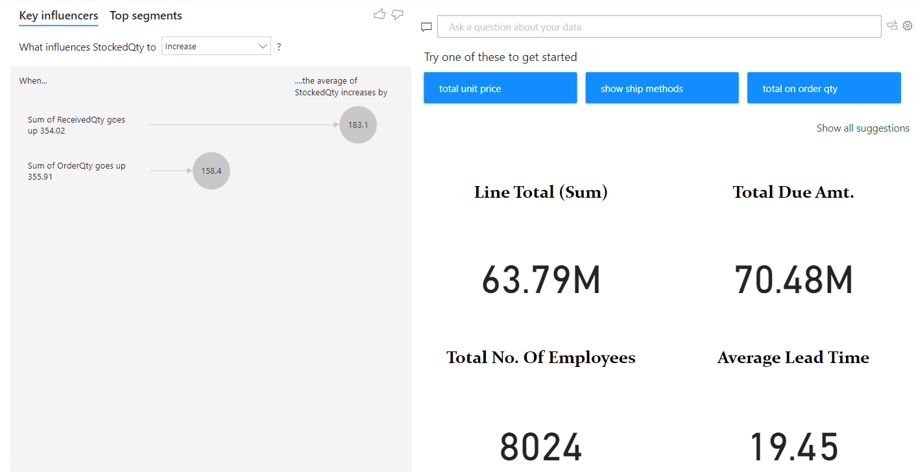
Report View

Slide 10
Findings & Insights
There are 3 factors contributing to the total dues: Tax amount, freight and sub-totals, latter being the largest contributor (over 90%).
No of ordered quantity keeps increasing after 2013, regardless of the quarter, indicating that the sales would be the highest during that phase.
Superior bicycles had the highest average price ($79) whereas Super sales Inc. had the lowest ($0.2). The top 5 mostly consisted of bicycle vendors.
Overseas-deluxe had the highest ship rate.
Key influencers chart uses AI to demonstrate how fields are connected and dependent on each other, like the dependency of stocked quantity over ordered quantity.

Slide 11


Thank You
Any questions!?
Presented by:
Bhaskar & Priyanka
2022

